Slide 1
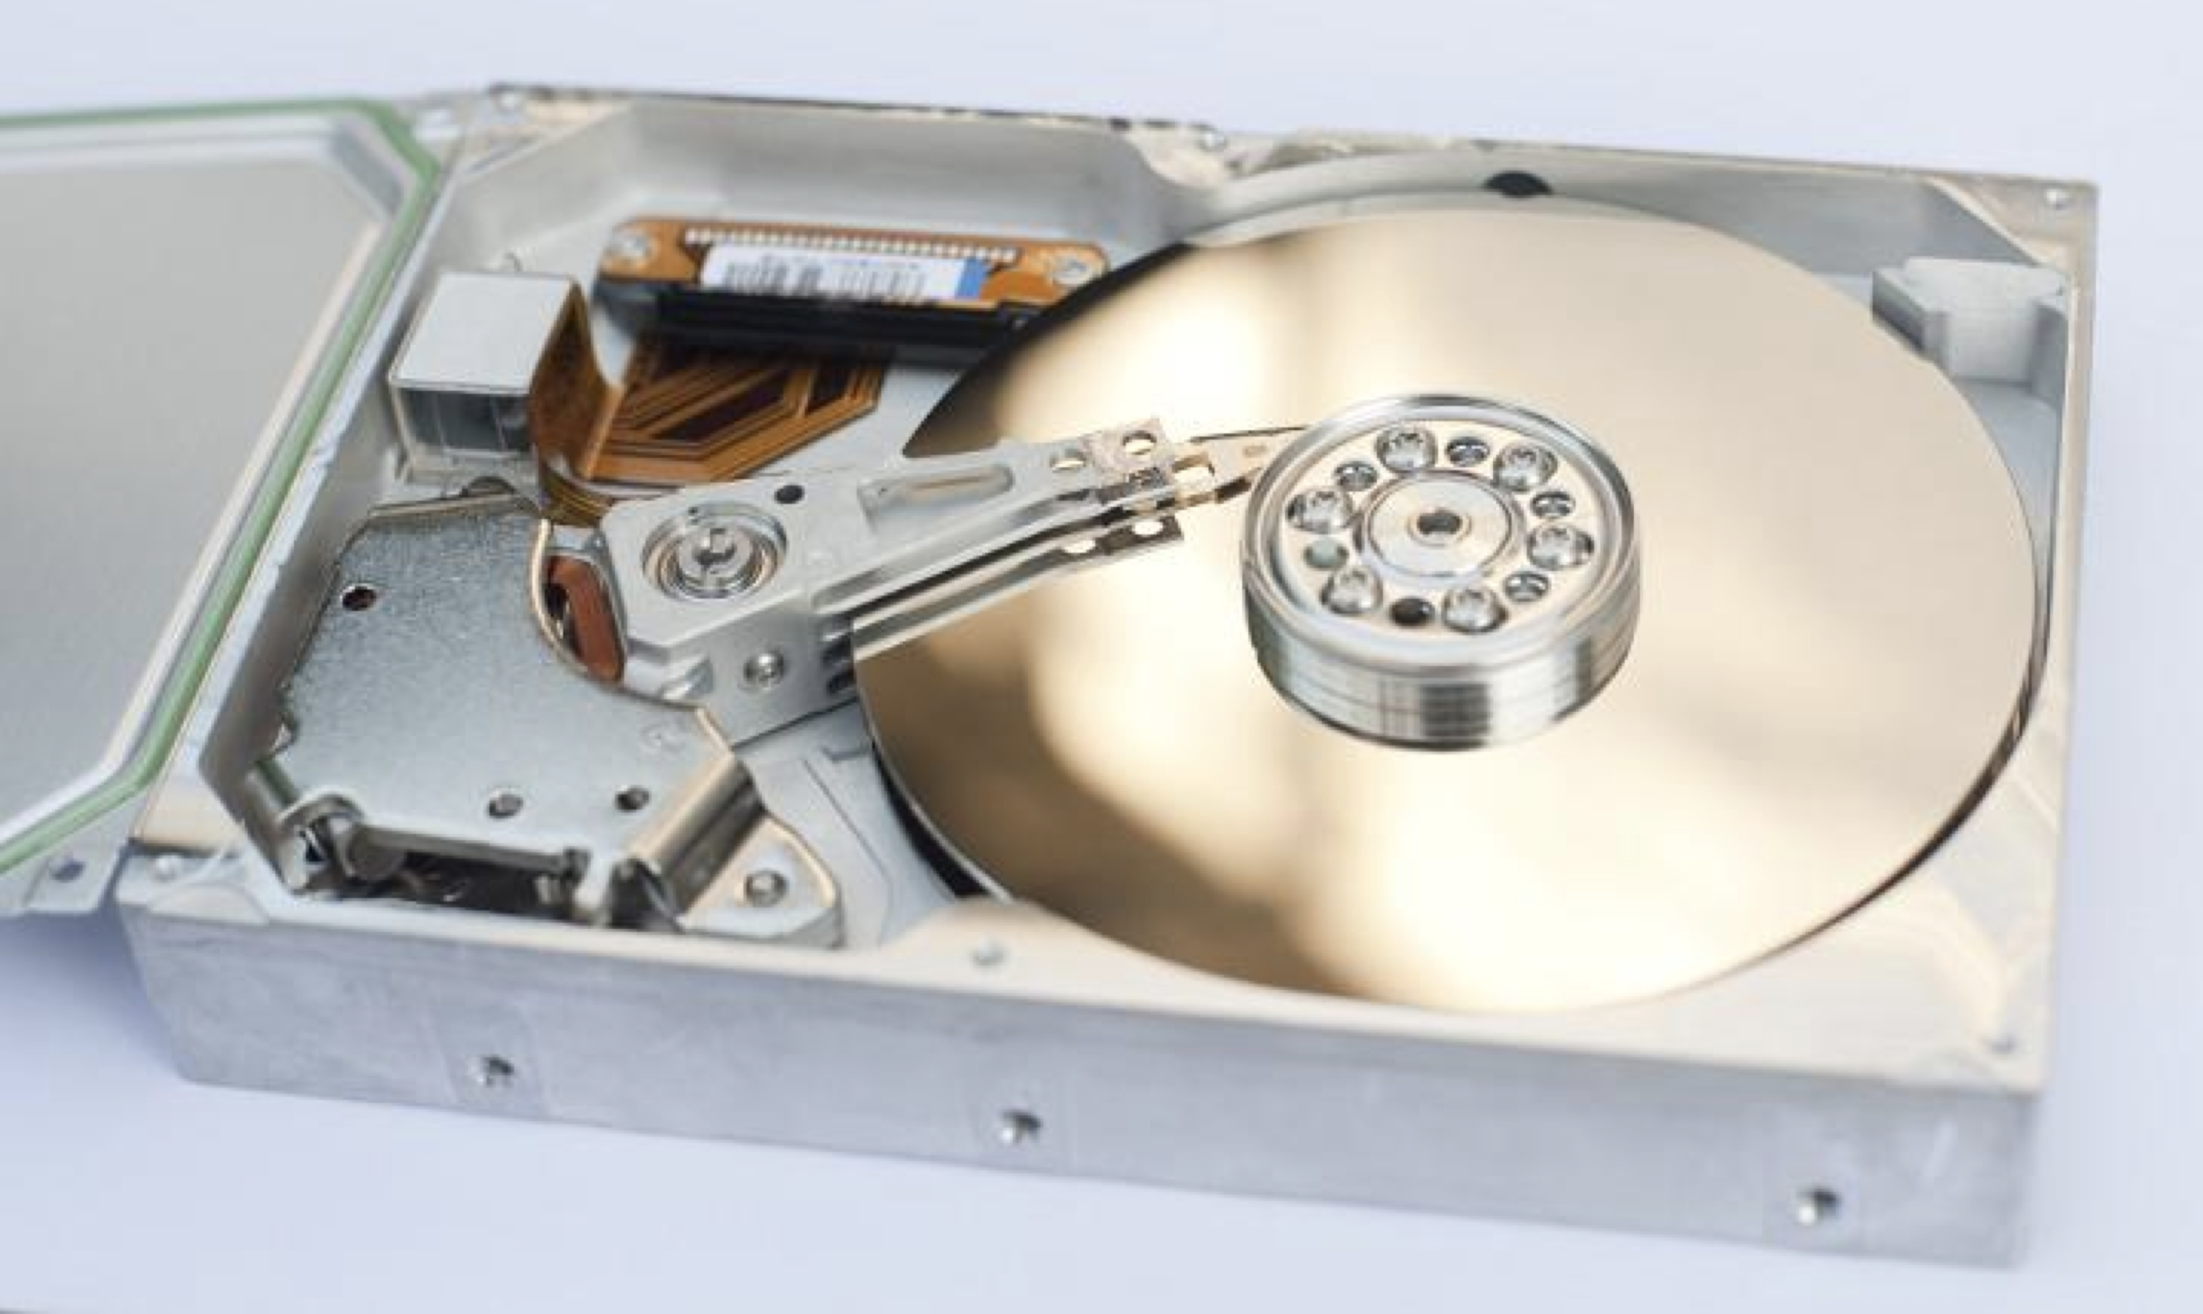
Industrial Machine Learning on Hadoop and Spark
Maks Nakhodnov, Bremen 2025

Slide 2
Distributed computing. Spark Streaming
Plan:
Streaming data, where to find it
Failure scenarios. Handling data loss scenarios
Lambda architecture
Spark Streaming & DStream. Structured Streaming
Integration with MLlib

Slide 3
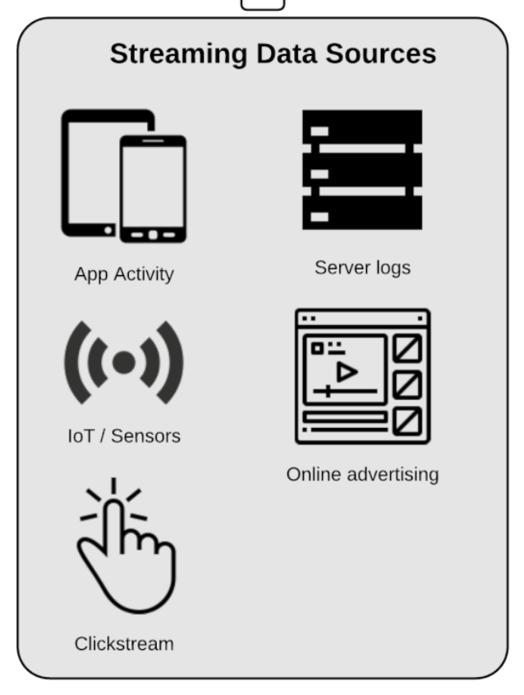
Streaming data and where to find it?
IoT Sensors
Server logs and security logs
Real-time advertising
Clickstream data from applications and websites

Slide 4
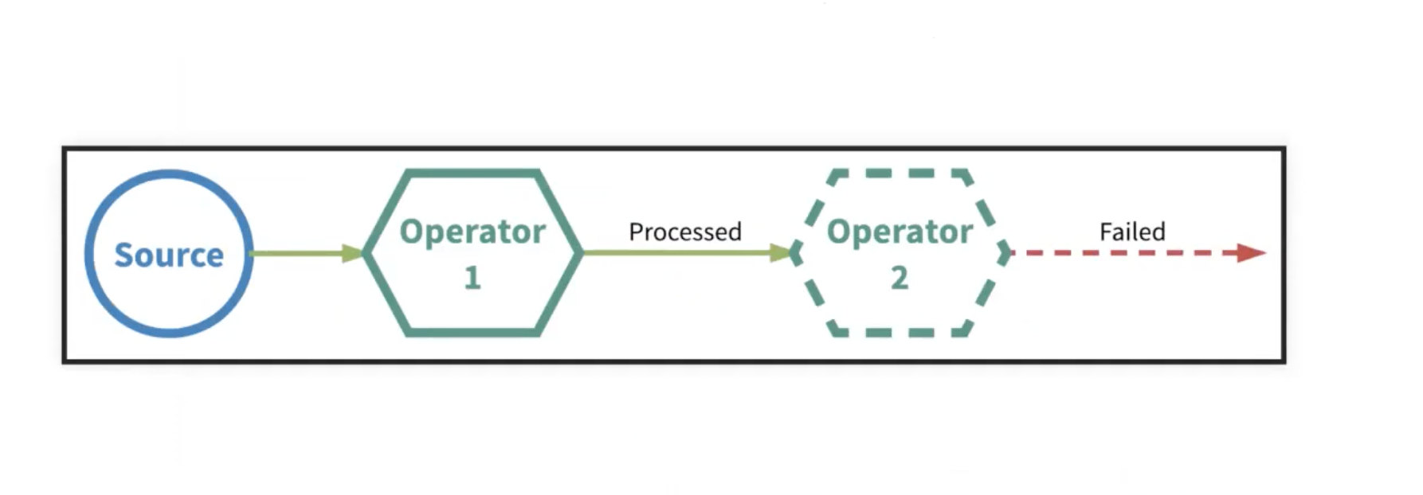
Failure scenarios. Failure during processing. At-most-once

Slide 5
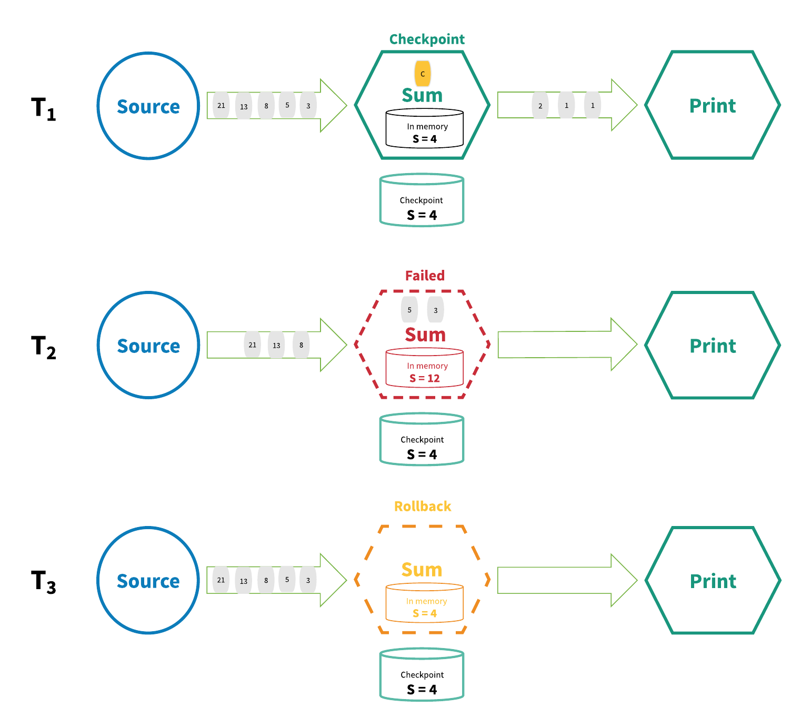
Failure scenarios. Distributed Snapshot
The state for each operator in the streaming application is periodically checkpointed
In the event of a failure, all the state is rolled back to the most recent globally consistent checkpoint
Sources are reset to the offset corresponding to the checkpoint
The application is rewound to its most recent consistent state, processing can then restart from that state

Slide 6
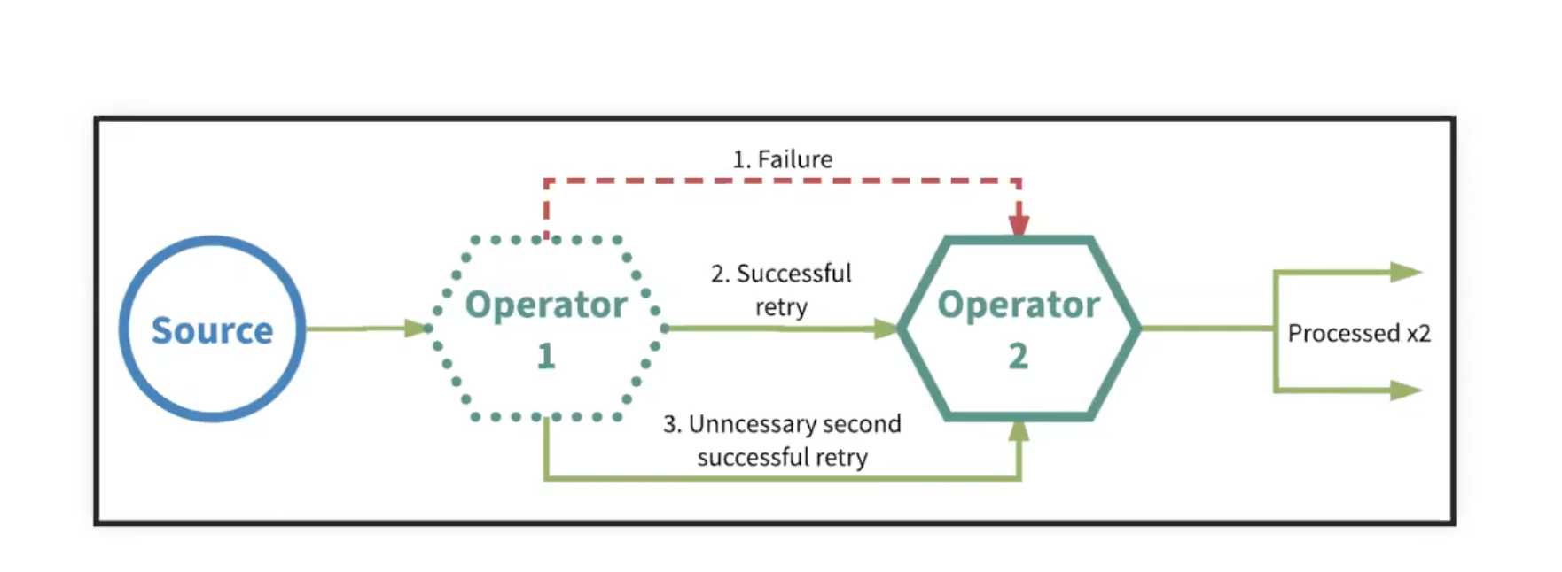
Failure scenarios. Failure during sending the processing result response. At-least-once

Slide 7
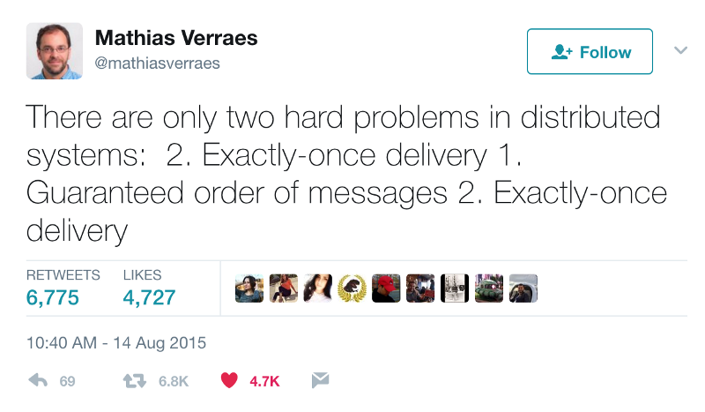
Failure scenarios. At-least-once event delivery. Message deduplication

Slide 8
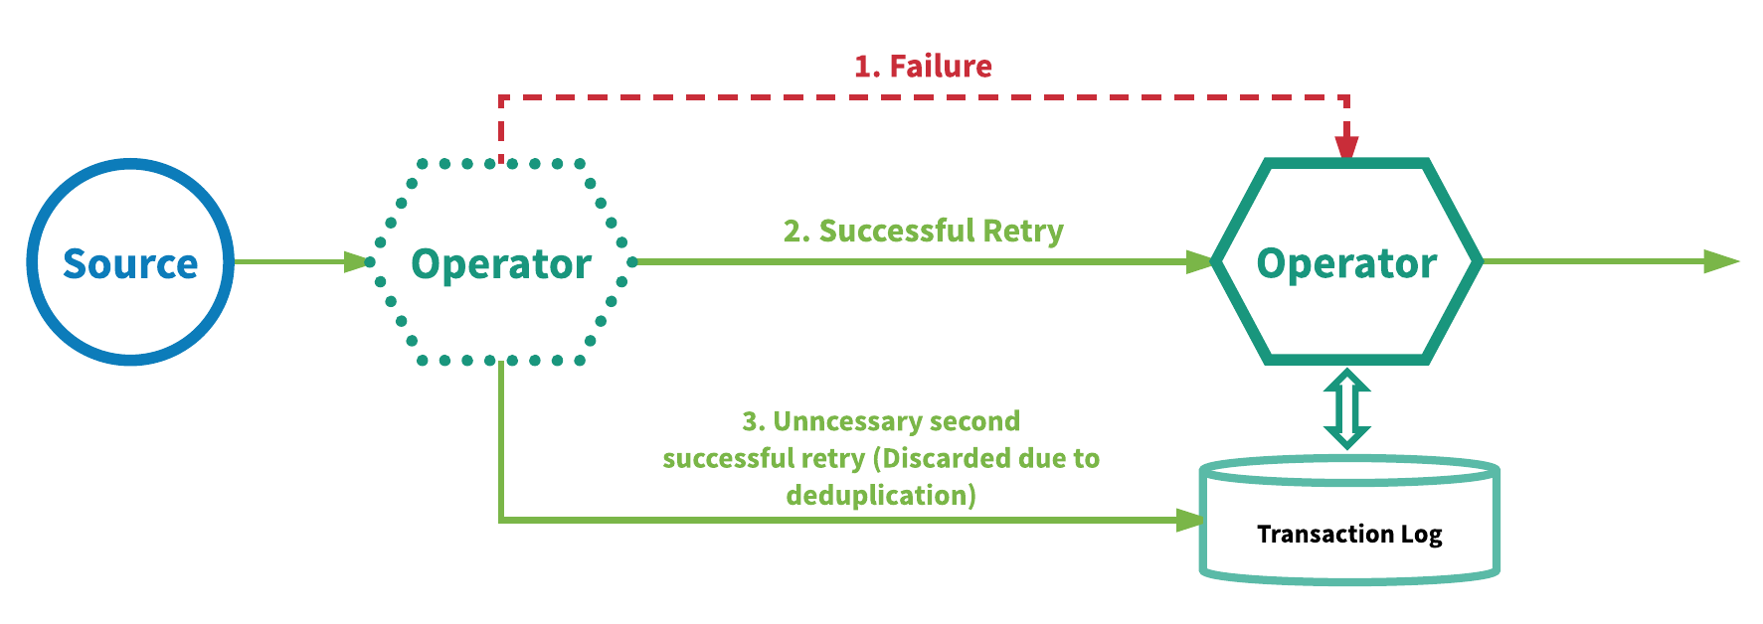
Failure scenarios. At-least-once event delivery. Message deduplication

Slide 9
End-to-end Exactly One Guarantee
At-least-once delivery plus deduplication:
Performance impact of failures are localized
Impact of failures does not necessarily increase with the size of the topology
Potentially need large amounts of storage and infrastructure to support
Performance overhead for every event at every operator
Distributed snapshot:
Little performance and resource overhead
Larger impact to performance when recovering from failures
Potential impact to performance increases as topology gets larger
In all cases, the final state of the data in the storage will be exactly the same as if there were no failures and each message was processed exactly once.
It does not guarantee exactly once processing!

Slide 10
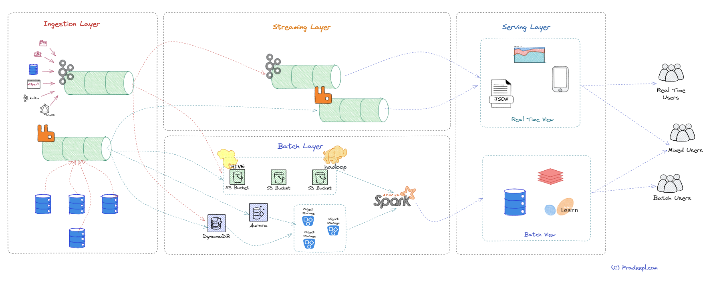
Lambda architecture
Lambda architecture combines two separate data pipelines:
Batch Layer for processing large volumes of historical data
Speed (streaming) Layer for real-time stream processing for low-latency views of data

Slide 11
Spark Streaming & DStream

Slide 12
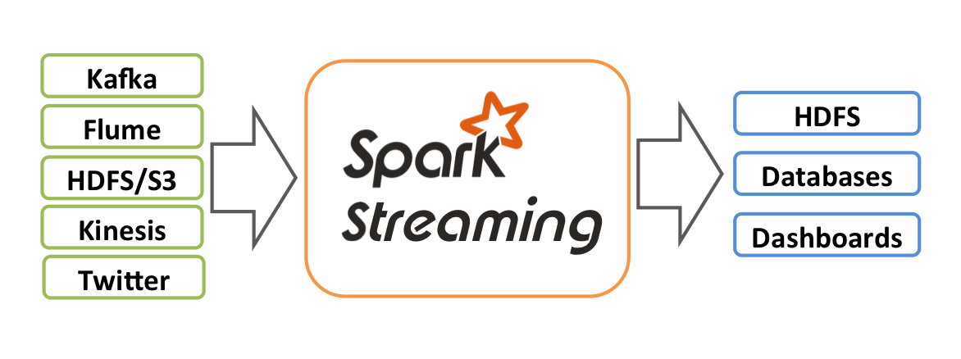
Spark Streaming

Slide 13
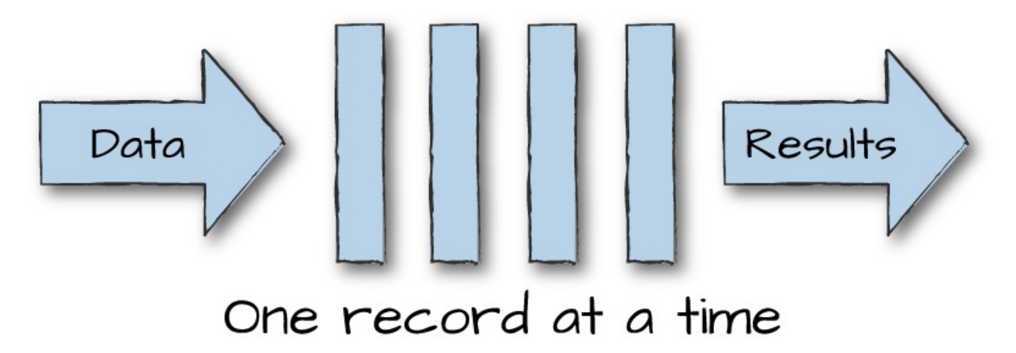
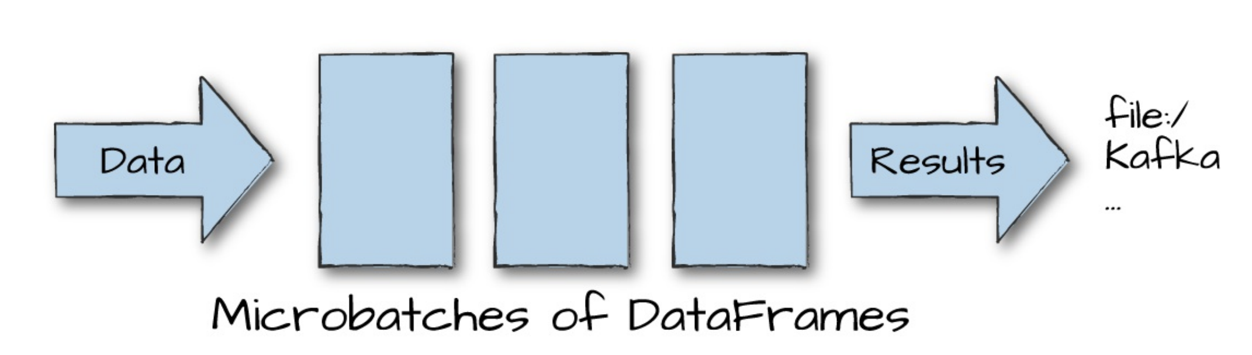
Spark Streaming. Micro Batches

Slide 14
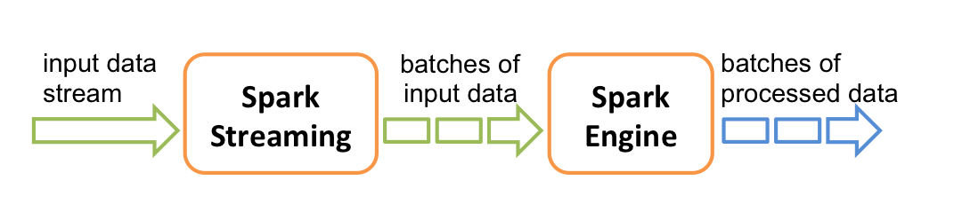
Spark Streaming. Programming model

Slide 15
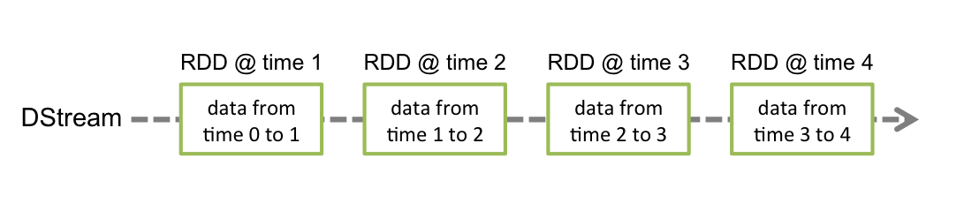
DStream. RDD Sequence
DStream (Discretized Stream) — the basic abstraction of Spark Streaming
Represents a continuous stream of data (from a source or after processing)
Internally implemented as a sequence of RDDs
Each RDD contains data for a fixed time interval

Slide 16
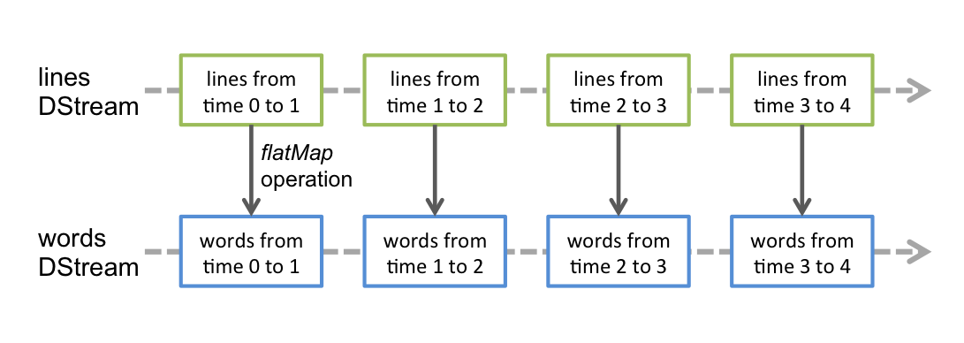
DStream. RDD Sequence

Slide 17
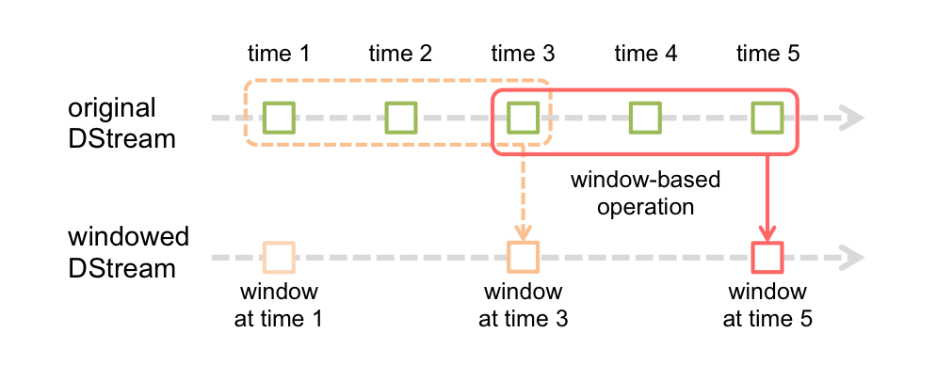
DStream. Window operations

Slide 18
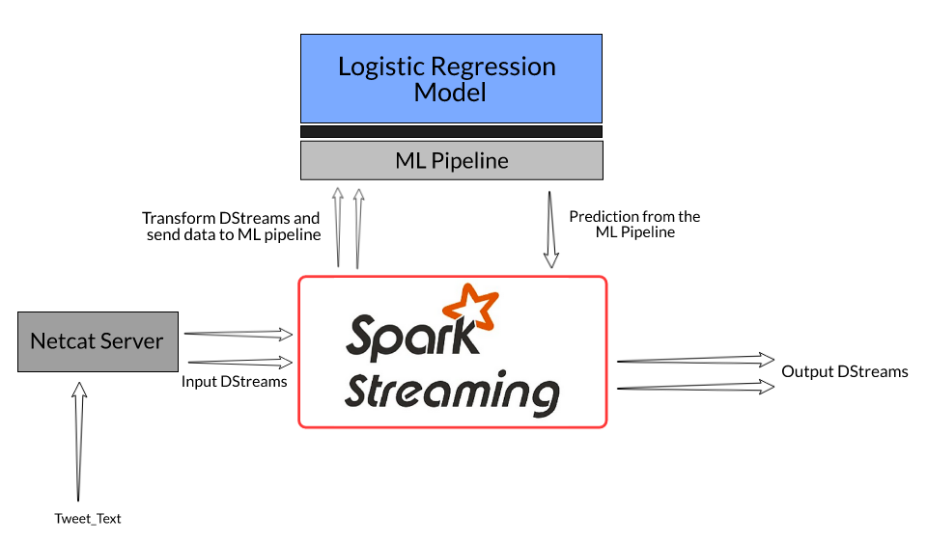
DStream. MLlib
Using MLlib: easy integration of machine learning algorithms
Streaming learning: simultaneous training and inference of the model (StreamingLinearRegression, KMeans)
Offline learning: training on historical data and applying the model to the stream in real-time

Slide 19
Structured Streaming & DataFrame

Slide 20
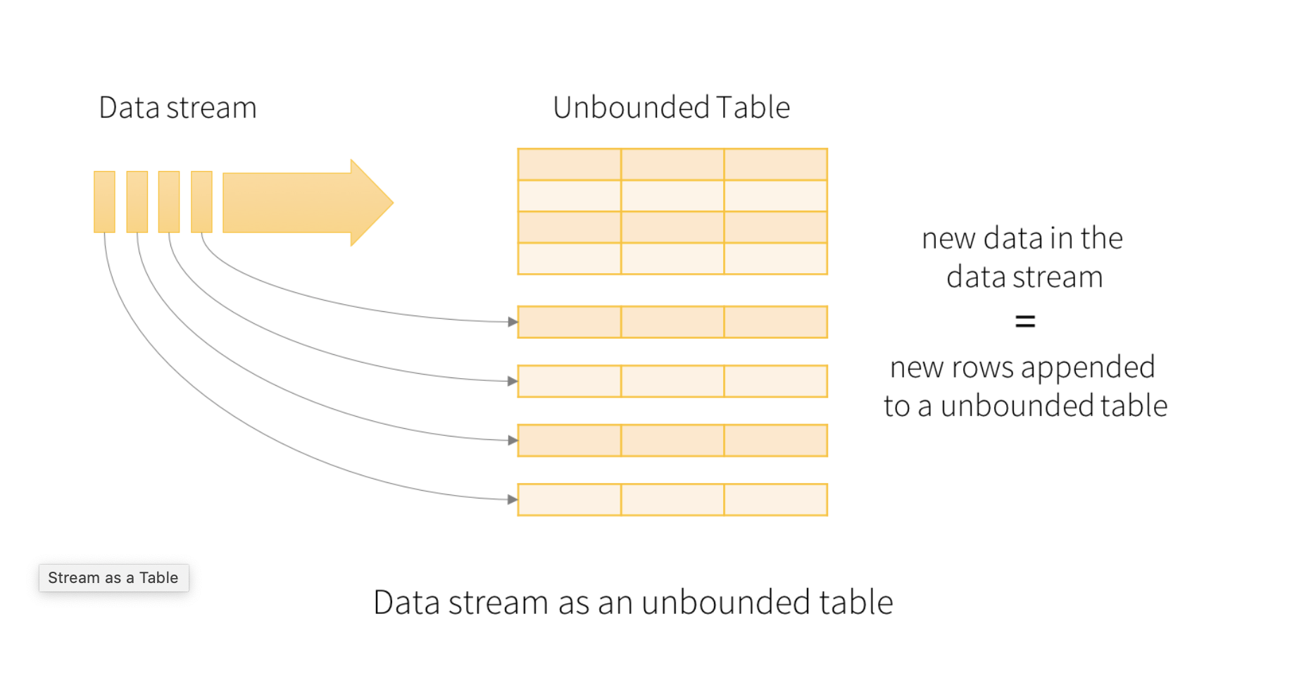
Structured Streaming. Programming model
Key idea: the data stream is treated as a constantly growing table
Unification: the stream processing model is close to the batch processing model
API: standard queries are used, just like for static data
Execution: Spark runs them as incremental queries against the Unbounded Table

Slide 21
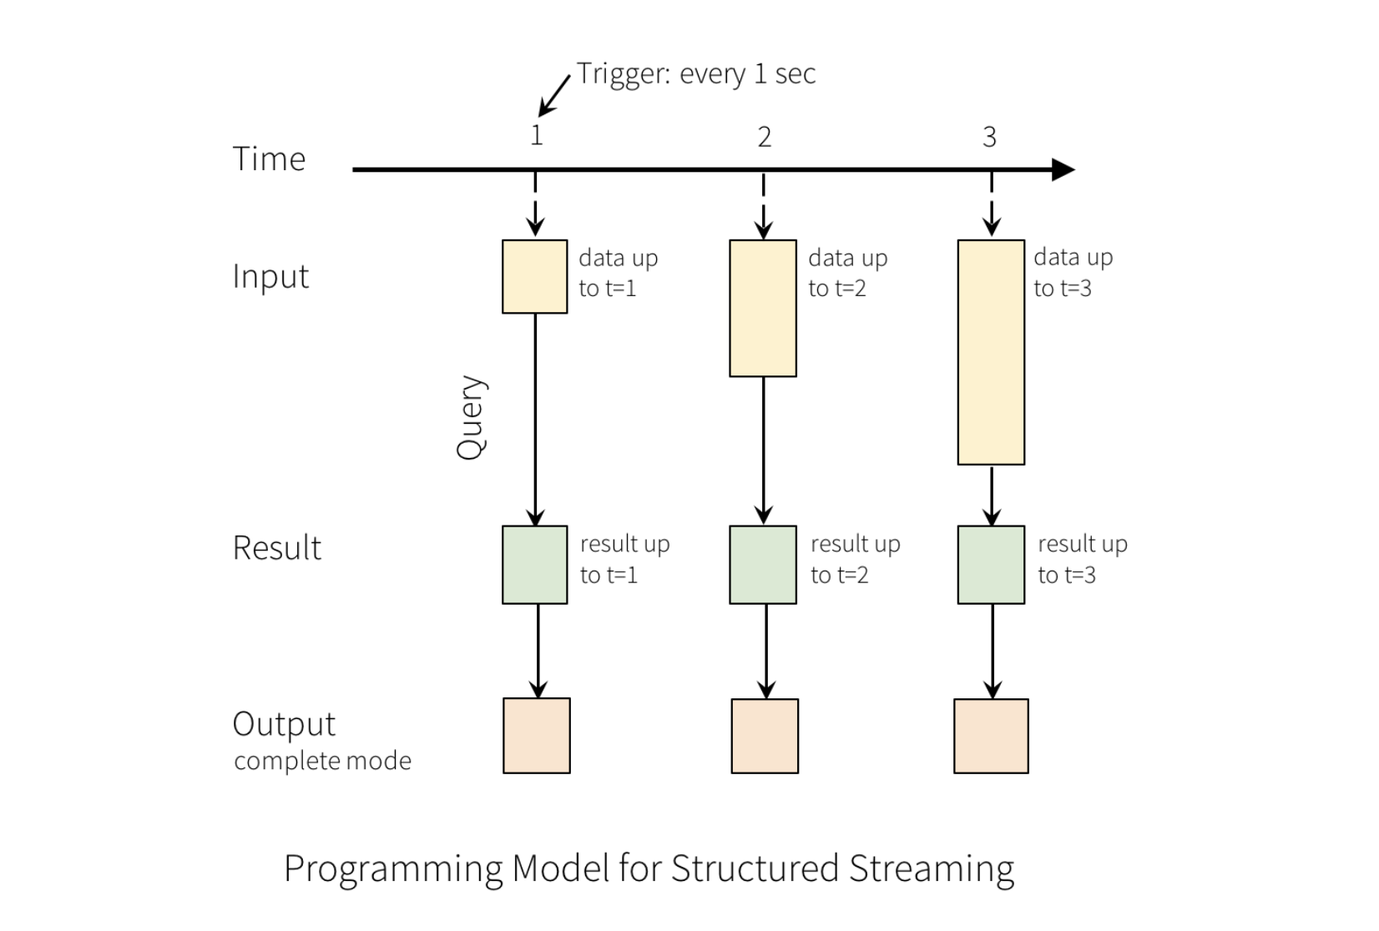
Structured Streaming. Programming model

Slide 22
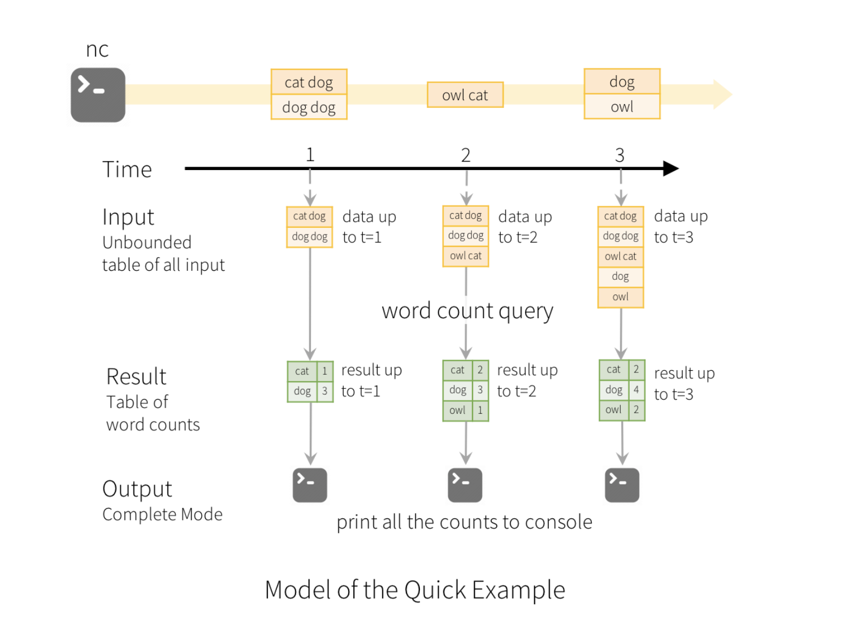
Structured Streaming. Example

Slide 23
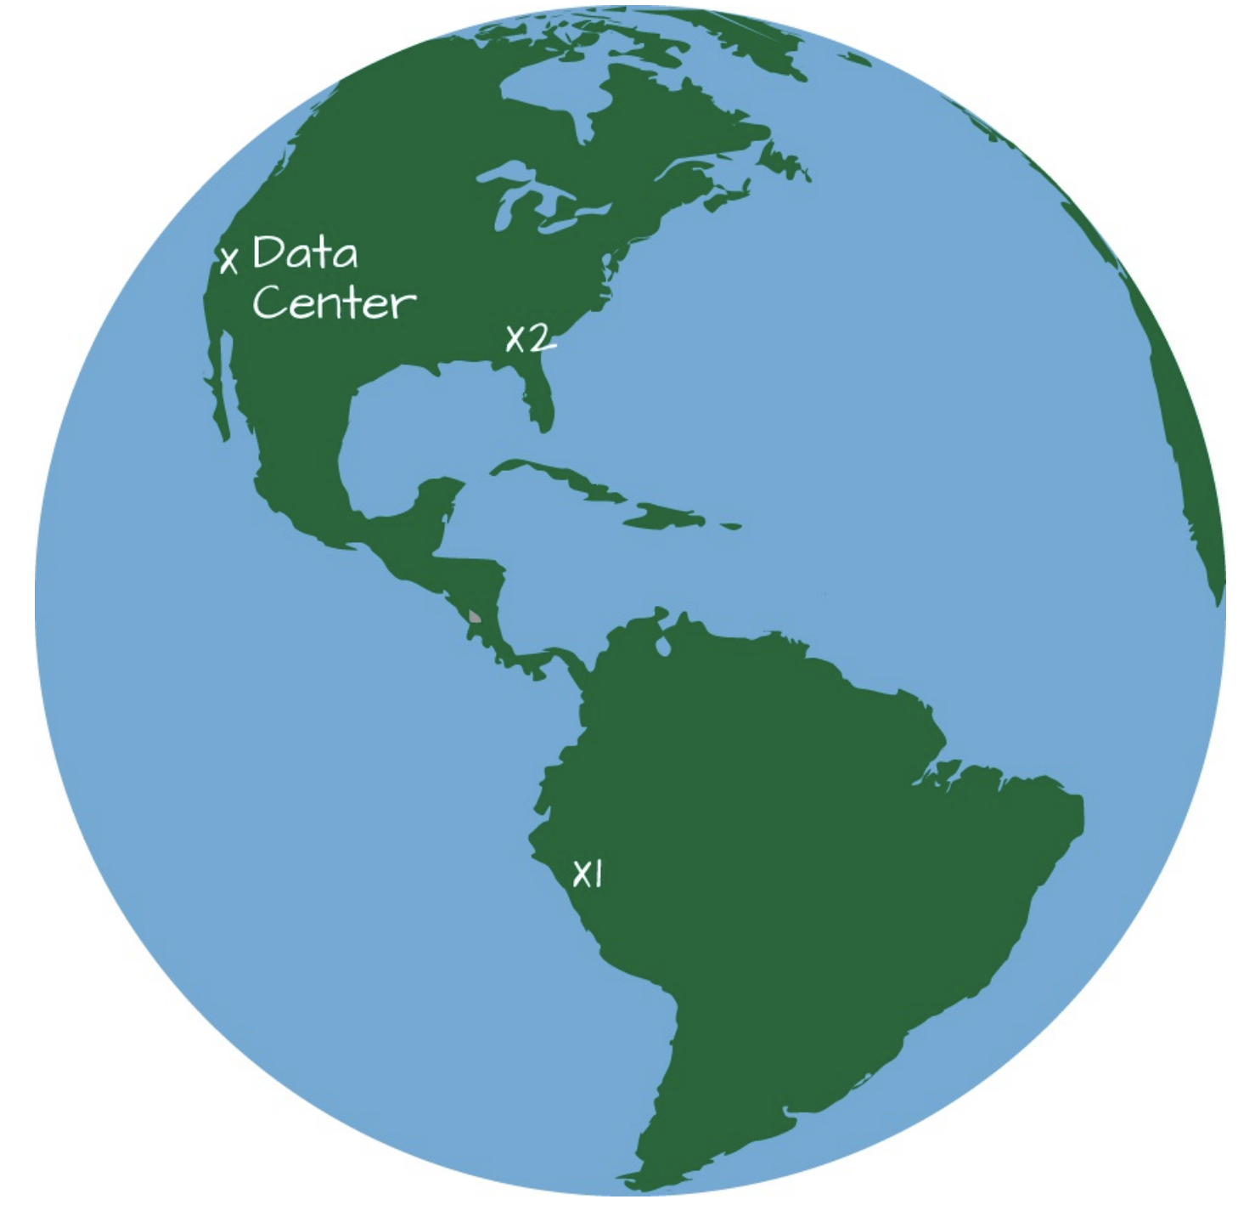
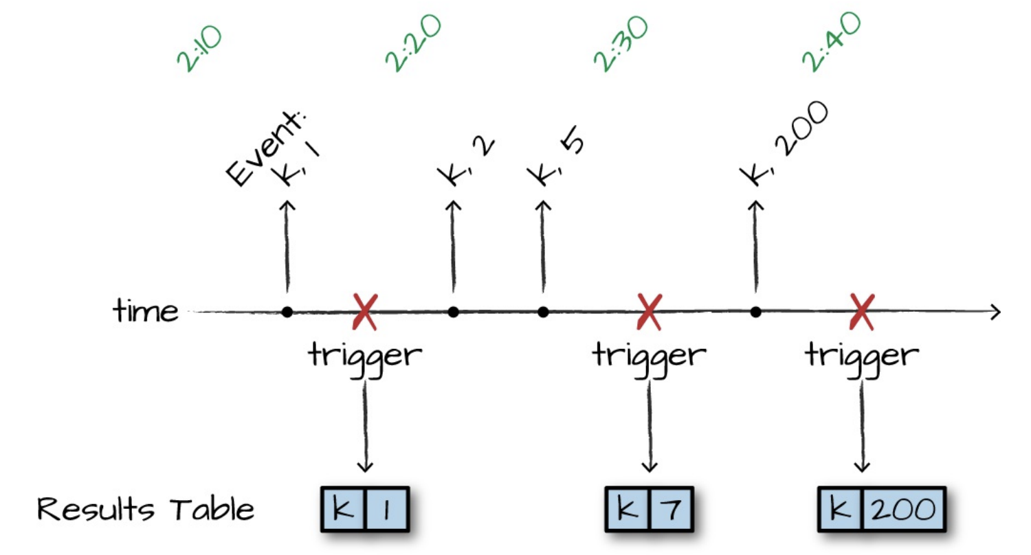
Structured Streaming. Event Processing

Slide 24
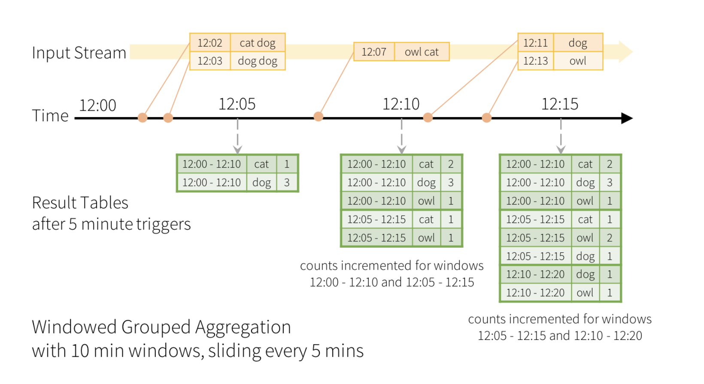
Structured Streaming. Event Processing

Slide 25
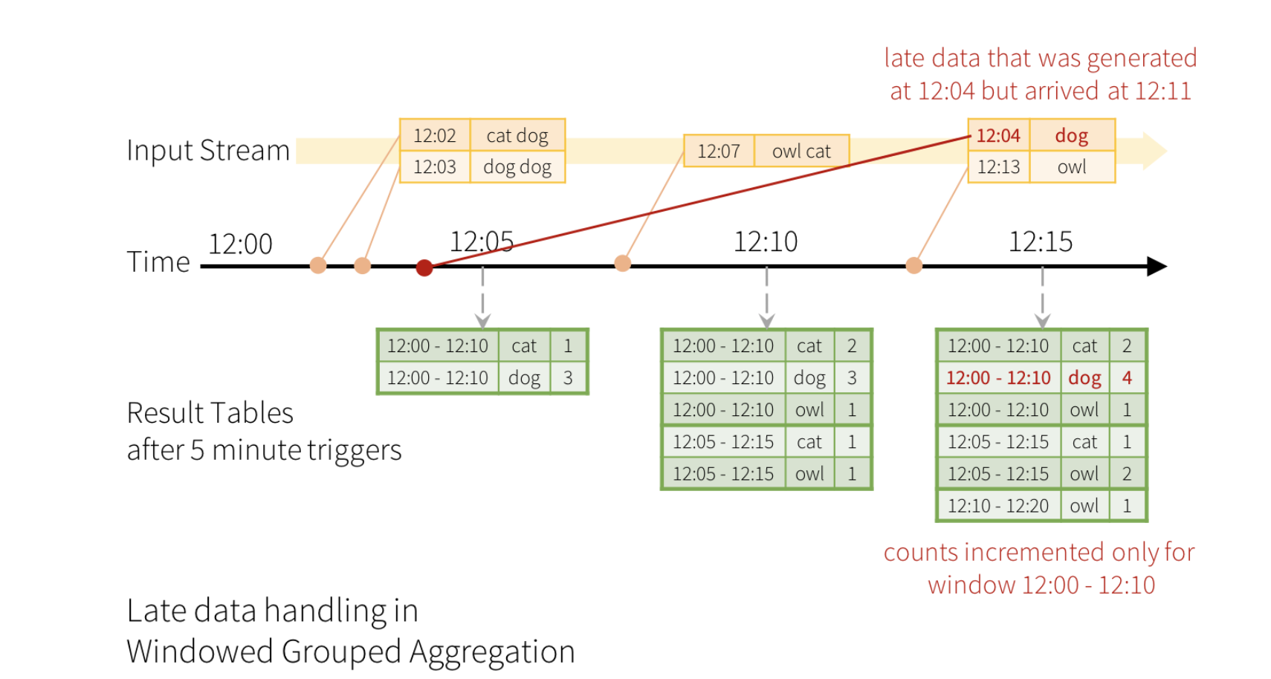
Structured Streaming. Late Data

Slide 26
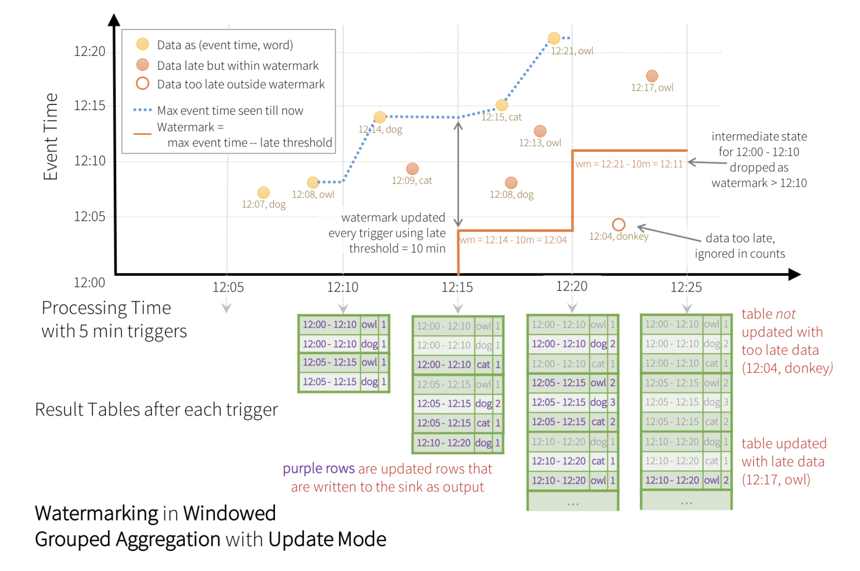
Structured Streaming. Watermarking

